Slide 1


Microsoft Fabric and Azure DevOps – The story so far as we end 2024
Kevin Chant
Microsoft Fabric
Azure DevOps

Slide 2
Managing expectations
Are posts available relating to demos shown
All on Trial tenant (no NDA material)
Includes details about new Microsoft CI/CD workflows document
SQL database in Fabric covered

Slide 3
Agenda
Bio
Intro to Microsoft Fabric
Intro to Azure DevOps
Configuring Azure Repos for Git integration
Using Azure DevOps with suggested CI/CD workflow options
CI/CD for Data Warehouses and SQL database in Fabric

Slide 4

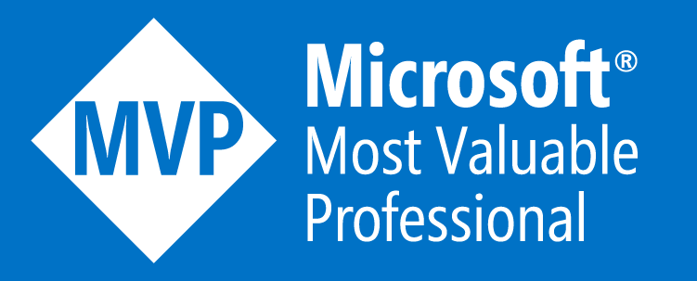


Kevin Chant
Data Engineering Manager in the Netherlands
Worked in IT since the days of Windows 95
Experience in various sectors
Various certifications, Data Platform MVP
Twitter/Blue Sky: @kevchant
LI: https://www.linkedin.com/in/kevin-chant/
Blog: https://www.KevinRChant.com
GitHub: https://github.com/kevchant
Email: Available upon request

Slide 5











Lake centric and open
Empower every Business user
Microsoft Fabric
Comp analytics platform
AI Powered
Power BI
Databases
Data Activator
Industry Solutions
Real-Time Intelligence
Data Engineering
Data Science
Data Warehouse
OneLake
Compliance & Governance
CI/CD requirements
Microsoft Purview
Azure DevOps

Slide 6
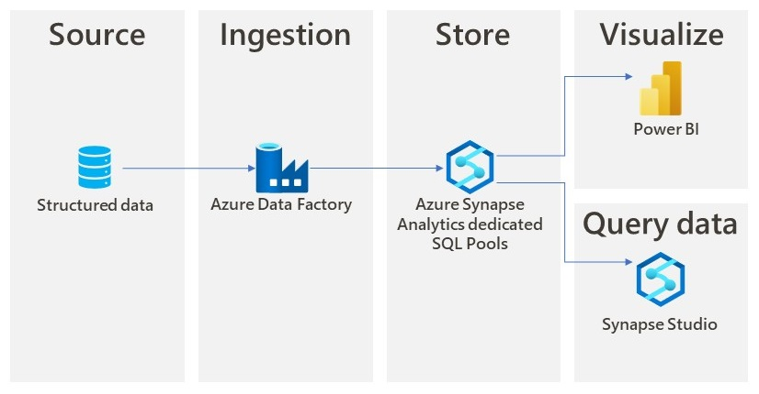
Integrating various services

Slide 7
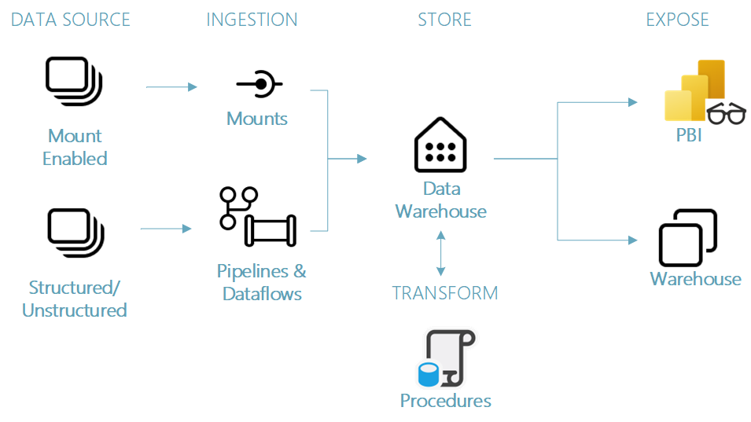
Within Microsoft Fabric

Slide 8

Fabric Demo

Slide 9
Azure DevOps
Manages Application Lifecycle Management
Collection of services
Two main versions

Slide 10
Azure DevOps Demo

Slide 11
About Microsoft Fabric Git Integration
Allows supported items in a workspace to have metadata synchronized with a Git repository.
To be more precise a workspace synchronizes with a branch.
Items supported at various levels.
Supports Azure DevOps and GitHub cloud-based offerings.
Requires Fabric or Power BI Premium capacity.

Slide 12
Configuring AzDo for Microsoft Fabric Git Integration
Utilizes Microsoft Entra ID authentication.
Both workspace and repository require access.
Entra user needs to be on same tenant, Azure DevOps org does not!

Slide 13
Security considerations
Keep organization & repository in relevant region.
Keep organization private.
Consider GitHub Advanced Security for Azure DevOps.

Slide 14

Git integration Demo
Microsoft Fabric workspace
Azure DevOps

Slide 15
Using Azure DevOps with suggested CI/CD workflow options
Microsoft released document in September.
Highlight how Azure DevOps fits into suggested CI/CD workflows.

Slide 16


Recommended development process
Items changed in feature workspace owned by user
Feature branch in Azure DevOps
Main or dev branch
Items changed by IDE to Git repository on local machine

Slide 17
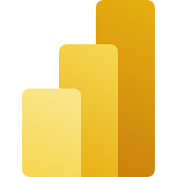
One step further by introducing unit tests
Power BI report changed in feature workspace
Pull request raised
CI checks passed
Feature branch in Azure DevOps
Azure Pipeline runs. Performing CI tests using Tabular Editor and PBI Inspector
Main or dev branch updated
Power BI changed locally in Power BI Desktop to Git repository on local machine

Slide 18
Release Option 1 – Git-based deployments
Deploy to multiple workspaces connected to the same Git repository.
Achieved by having workspaces connected to different branches.

Slide 19
Release Option 1 - Diagram
Items changed in feature workspace owned by user
Feature branch in Azure DevOps
Main or dev branch
Production workspace updated
Items changed by IDE to Git repository on local machine

Slide 20
Release Option 2 – Git-based deployments using build pipeline
Deploy to different workspaces using Azure Pipelines.
Recommendation is that each workflow contains a build and release process.
Build for unit tests.
Release to perform update.
Note that for various APIs only Power BI items are supported by service principals at this moment in time.

Slide 21
Release Option 2 - Diagram
Items changed in feature workspace
Pull request raised
Feature branch in Azure DevOps
Main branch
Azure DevOps pipeline runs
Production workspace updated
Items changed by IDE to Git repository on local machine

Slide 22
Azure Pipeline recommendations
Consider YAML Pipelines.
You cannot do a PR on a classic pipeline!
Self-hosted Azure Pipeline agents to keep workload secure.
Keep sensitive values in either:
Variable groups.
Azure Key Vault
Implement approvals process for production workloads.

Slide 23
Release Option 3 – Deploy using Microsoft Fabric deployment pipelines
Perform your pull request from feature branch to branch connected to a workspace that represents Dev stage of a deployment pipeline.
From there orchestrate using Microsoft Fabric deployment pipelines.
Alternatively, orchestrate to different Microsoft Fabric deployment pipeline stages using Azure DevOps.

Slide 24
Release Option 3 - Diagram
Performed via Git integration and Azure DevOps
Performed via Fabric Deployment pipelines
Pull request raised between Git branches
Deploy done via deployment pipeline
Deploy done via deployment pipeline
Supported items changed in Feature workspace
Feature branch changes merged with Development branch in Git repository
Supported items changed in Development workspace that is part of deployment pipeline
Supported items changed in Test workspace
Supported items changed in Production workspace

Slide 25
Orchestrated by Azure Pipelines
Performed via Git integration and GitHub
Orchestrated by Azure Pipelines
Pull request raised between Git branches
Deploy done via Azure pipeline
After approval deployment done via Azure pipeline
Supported items changed in Feature workspace
Feature branch changes merged with Development branch in Git repository
Supported items changed in Development workspace that is part of deployment pipeline
Supported items changed in Test workspace
Supported items changed in Production workspace

Slide 26
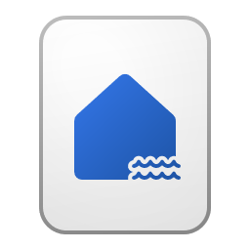
Another advantage of Azure Pipelines
Performed via Git integration
Orchestrated by Azure Pipelines
Deploy done via Azure Pipeline
Deploy done via Azure Pipeline
Notebook call through API in YAML Pipeline
Supported items changed in Development workspace that is part of deployment pipeline
Supported items changed in Test workspace
Supported items changed in Production workspace
Lakehouse populated

Slide 27
Release Option 4 – For multiple customers/solutions/tenants
Dev and test stages are managed in same Fabric tenant.
Deployment to Prod stages to workspaces in other tenants using Azure Pipelines

Slide 28
Release Option 4 - Diagram
Update performed either via Git integration or Azure Pipelines
Customer a workspace in another tenant
Supported items updated in Dev workspace in own tenant
Supported items updated in Test workspace in own tenant
Azure Pipelines
Customer b workspace in another tenant
Customer x workspace in another tenant

Slide 29
Demos
Power BI Desktop Projects
Deploying to multiple workspaces via Git integration
Deploying via deployment pipelines

Slide 30
CI/CD methods for Data Warehouses and SQL databases in Fabric
Can connect to Data Warehouse and SQL database in Fabric via connection string
Allows deployment through traditional CI/CD methods.
State-based (dacpac)
Migration-based (potential caveats)
Supports Database Projects created in number of places.
CI/CD can be performed an Azure DevOps pipeline.

Slide 31



CI/CD for Data Warehouses
Pull request raised between branches
Dacpac deployed by Azure Pipelines (CD)
Database Project updated locally
Update is committed to Git repository in Azure Repos
Dacpac created from stored Database Project by Azure Pipeline (CI)
Schema in Data Warehouse updated

Slide 32
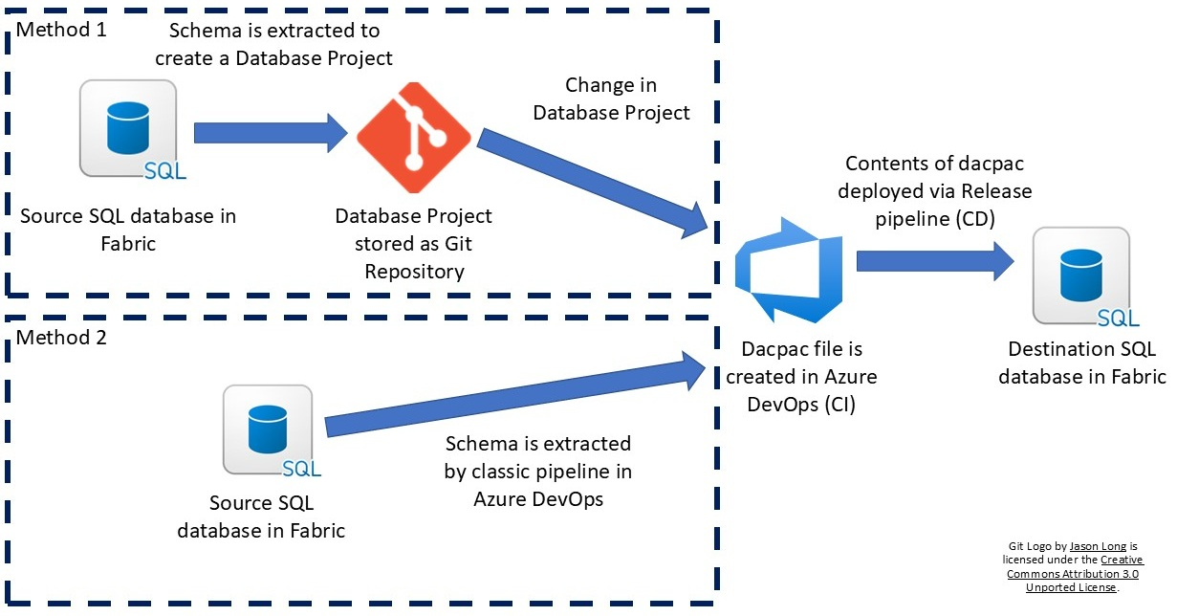
CI/CD for SQL databases in Fabric

Slide 33
Demos
CI/CD for Data Warehouses.
CI/CD for SQL database in Fabric

Slide 34

Questions

Slide 35

Thank you
Twitter/Bluesky: @kevchant
LI: https://www.linkedin.com/in/kevin-chant/
Blog: https://www.KevinRChant.com
GitHub: https://github.com/kevchant

Slide 36
Links shared
Thoughts about disabling classic pipelines in Azure DevOps
Introduction to Git integration
Power BI Desktop projects
Power BI Project (PBIP) and Azure DevOps CI performance tests

Slide 37
Additional links shared
Working with Microsoft Fabric Git integration and multiple workspaces
Initial tests to copy a Direct Lake semantic model to another workspace using Microsoft Fabric Git integration
Introduction to deployment pipelines
CI/CD for Microsoft Fabric Data Warehouses using Azure DevOps

